Slide 1
S Q L P R O J E C T Corona Virus Analysis
-Dhanushavarthini S

Slide 2

OBJECTI VE
The CORONA VIRUS pandemic has had a significant impact on public health and has created an urgent need for
data-driven insights to understand the spread of the virus. The task is to derive
insights using SQL from the dataset containing information such as geographic location, dates, confirmed case, deaths, and recoveries.

Slide 3
Description of each column in the dataset:
01. P ROVINCE: GEOGRAPHIC SUBDIVISION WITHIN A COUNTRY/REGION
02. Country/Region: Geographic entity where data is recorded.
03. Latitude: North-south position on Earth's surface
04. Longitude: East-west position on Earth's surface.
05. Date: Recorded date of CORONA VIRUS data.
06. Confirmed: Number of diagnosed CORONA VIRUS cases.
07. DEATHS: NUMBER OF CORONA VIRUS RELATED DEATHS
08. R ECOVERED: NUMBER OF RECOVERED CORONA V I R US CASES

Slide 4
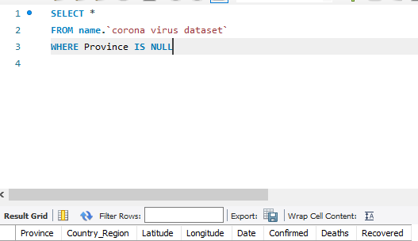
W R I T E A C O D E T O C H E C K NULL VALUES

Slide 5

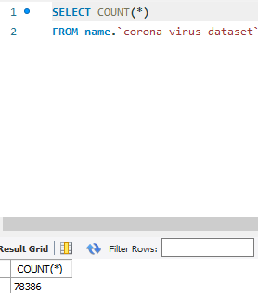
C H E C K T H E T O T A L N U M B E R O F R O W S

Slide 6
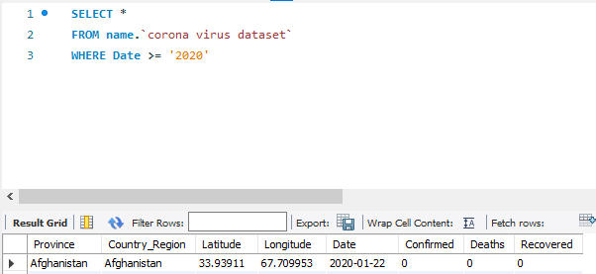
C H E C K T H E S T A R T _ D A T E A N D E N D _ D A T E

Slide 7
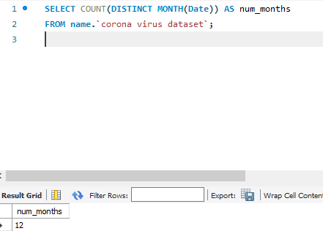
N U M B E R O F M O N T H S P R E S E N T I N T H E D A T A S E T

Slide 8
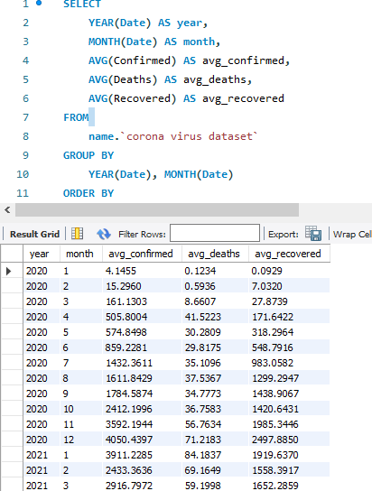
F I N D T H E M O N T H L Y A V E R A G E F O R C O N F I R M E D , D E A T H S , R E C O V E R E D

Slide 9
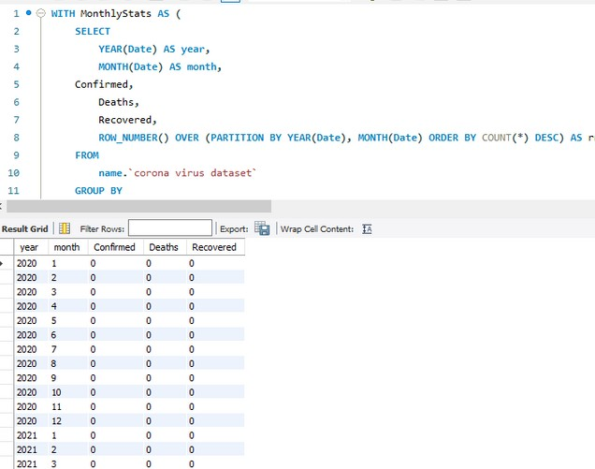
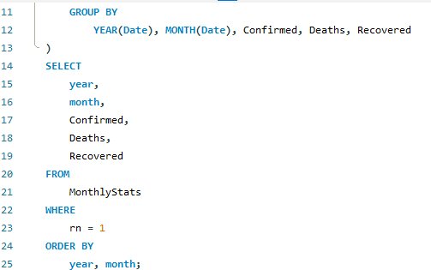
F I N D T H E M O S T F R E Q U E N T V A L U E
F O R C O N F I R M E D , R E C O V E R E D E A C H
D E A T H S , M O N T H

Slide 10
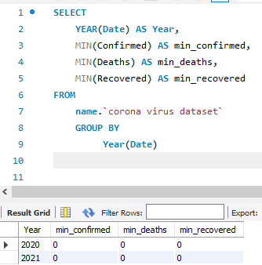
F I N D T H E M I N I M U M V A L U E S F O R C O N F I R M E D D E A T H S ,
R E C O V E R E D P E R Y E A R

Slide 11
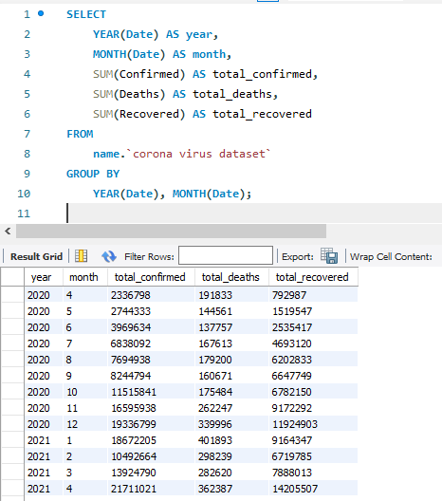
THE TOTAL NUMBER OF CASES CONFIRMED ,DEATHS,RECOVERED EACH MONTH

Slide 12
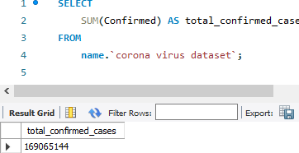
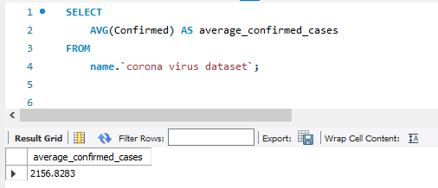
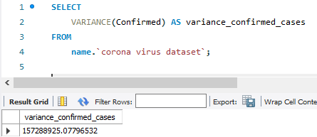
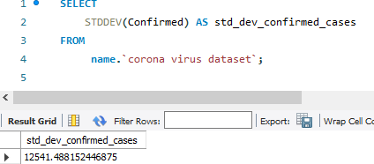
10:
C H E C K H O W C O R O N A V I R U S S P R E A D O U T W I T H R E S P E C T T O
C O N F I R M E D C A S E S ( E G . : T O T A L C O N F I R M E D C A S E S , T H E I R
A V E R A G E , V A R I A N C E & S T D E V )
I . )
C H E C K C O R O N A
I I . )
C H E C K C O R O N A
I I I . ) I V . )
H O W
V I R U S
H O W
V I R U S
C H E C K C O R O N A
H O W
V I R U S
C H E C K C O R O N A
H O W
V I R U S
S P R E A D O U T W I T H R E S P E C T T O T O T A L
S P R E A D O U T W I T H
S P R E A D O U T W I T H R E S P E C T T O T H E
S P R E A D O U T W I T H
R E S P E C T T O A V E R A G E
R E S P E C T T O T H E
S T D E V C O N F I R M E D C A S E S
C O N F I R M E D C A S E S
C O N F I R M E D C A S E S
V A R I A N C E O F
C O N F I R M E D C A S E S

Slide 13
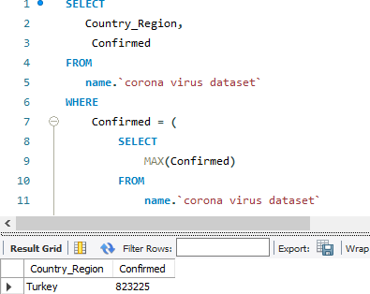
FIND THE COUNTRY THAT HAS THE HIGHEST NUMBER OF CONFIRMED CASES

Slide 14
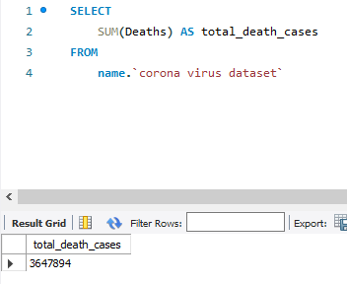
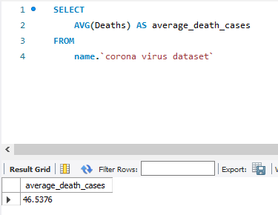
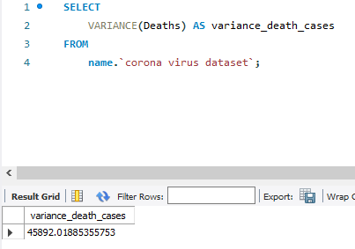
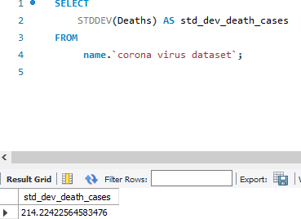
C H E C K H O W C O R O N A V I R U S S P R E A D O U T W I T H R E S P E C T T O D E A T H C A S E S P E R M O N T H
11:
- -
( E G . : T O T A L C O N F I R M E D C A S E S , T H E I R A V E R A G E ,
V A R I A N C E & S T D E V )
I . )
C H E C K C O R O N A
I I . )
C H E C K C O R O N A
I I I . )
I V . )
H O W
V I R U S
H O W
V I R U S
C H E C K C O R O N A
H O W
V I R U S
C H E C K C O R O N A
H O W
V I R U S
S P R E A D O U T R E S P E C T T O
W I T H T O T A L
S P R E A D O U T W I T H R E S P E C T T O
S P R E A D O U T W I T H R E S P E C T T O T H E
S P R E A D O U T W I T H
A V E R A G E D E A T H C A S E S
R E S P E C T T O T H E S T D E V D E A T H
D E A T H C A S E S
V A R I A N C E O F D E A T H C A S E S
C A S E S

Slide 15
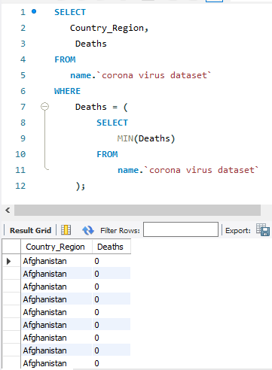
FIND THE COUNTRY THAT HAS THE LOWEST NUMBER OF CONFIRMED CASES

Slide 16
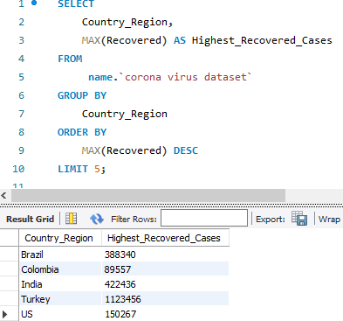
FIND THE TOP 5 COUNTRY THAT HAS THE HIGHEST RECOVERED CASES

Slide 17
thank you

